Slide 1
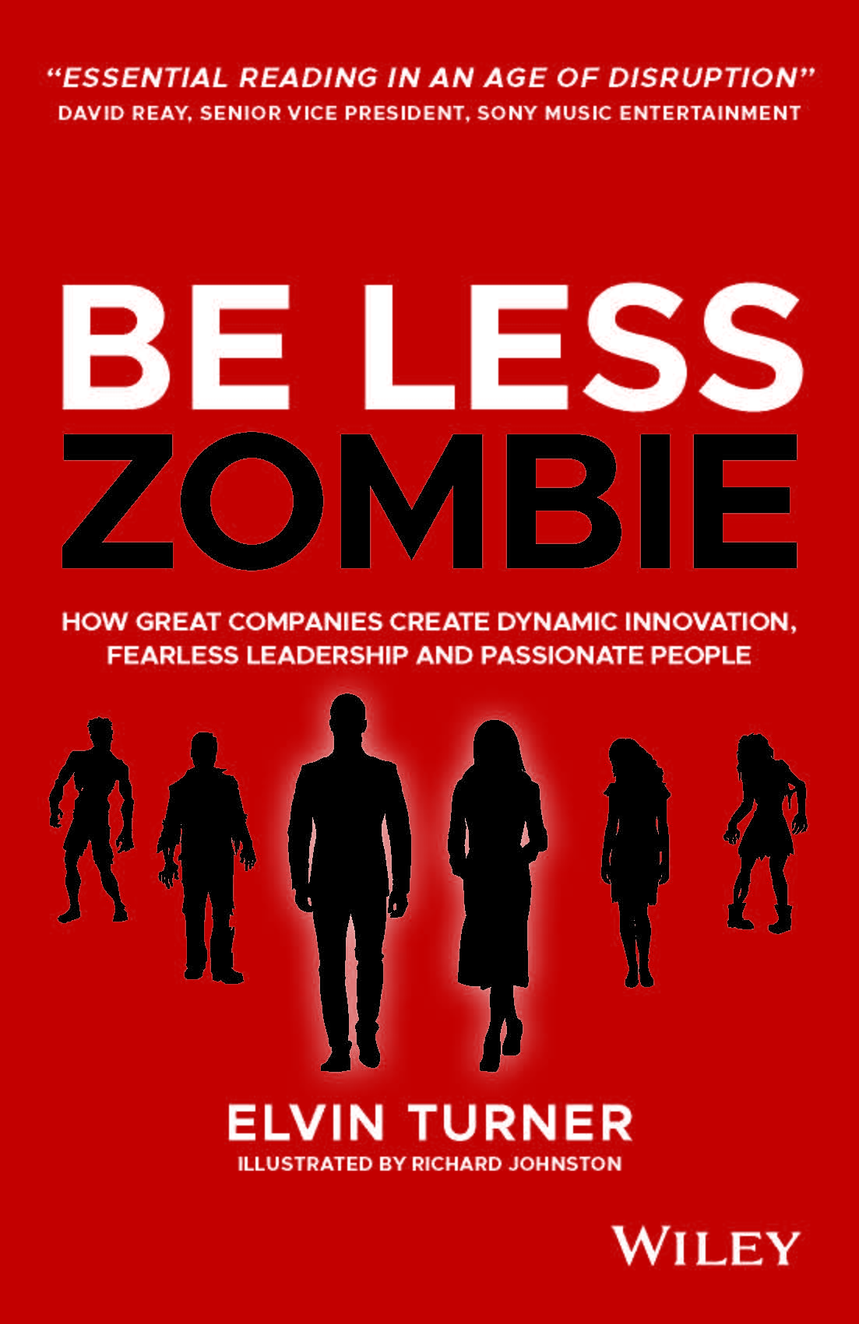
PROJECT CHARTER
Adapted from Be Less Zombie: How great companies create dynamic innovation, fearless leadership & passionate people.
Download this template and other resources from www.belesszombie.com/turniton

Slide 2
PROJECT CHARTER
1
2
3
4
5
PROJECT CONTEXT
SOLUTION ASSUMPTIONS
BUSINESS / ACCESS MODEL
MILESTONES & COMMUNICATIONS
SOLUTION OVERVIEW
It’s likely that your organisation already uses some form of project charter template. However, these templates can often lack the flexibility required for innovation projects which rarely develop as expected.
Use the following templates to help you design hybrid innovation project charters that fit your unique
organisational context.
And remember to keep returning to your charter throughout your innovation project. What you create at the start will inevitably change as you learn your way forward. So keep it updated especially as you validate (or otherwise) early assumptions that are critical to the project’s perceived valued to the organisation and its critical success factors.
Adapted from Be Less Zombie: How great companies create dynamic innovation, fearless leadership & passionate people.
Download this template and other resources from www.belesszombie.com/turniton

Slide 3
PROJECT CHARTER EXAMPLE: PROJECT CONTEXT
PROJECT CONTEXT
What problem / opportunity are we seeking to address?
What benefits do we believe are achievable (for all stakeholders)?
Why us? Why now?
What evidence supports our belief that this is sufficiently worthy of our attention?
GOALS:
How will success be measured:
By us?
By other stakeholders?
TIMESCALES:
In what timeframe must the project deliver its objectives?
BUDGET:
What approximate budget is required to deliver this project (or the next stage of the project)?
Adapted from Be Less Zombie: How great companies create dynamic innovation, fearless leadership & passionate people.
Download this template and other resources from www.belesszombie.com/turniton

Slide 4
PROJECT CHARTER EXAMPLE: SOLUTION OVERVIEW
SOLUTION OVERVIEW
Based on the specific opportunity / problem that we are addressing:
What is the proposed solution and how will it deliver value?
Which specific audience is it intended to serve?
In what context will the solution be used by that audience?
What benefits will it deliver to the audience in context? (What specific progress will it allow them to make in context)?
Originality and competitive advantage
How is the solution differentiated from alternative offerings in ways that we know are important to the target audience?
How defendable will the solution’s competitive advantage be?
Trends
What current, important trends does this solution align with?
What important trends are approaching in the near-medium term and what impact could they have on the future success of this solution (positive and negative)?
Adapted from Be Less Zombie: How great companies create dynamic innovation, fearless leadership & passionate people.
Download this template and other resources from www.belesszombie.com/turniton

Slide 5
PROJECT CHARTER EXAMPLE: SOLUTION ASSUMPTIONS
SOLUTION ASSUMPTIONS
DESIRABILITY:
FEASIBILITY:
VIABILITY:
What non-negotiable factors are needed to make this solution / project attractive to key stakeholders (users, customers, funders, internal stakeholders)?
What evidence supports these assumptions?
What non-negotiable factors are needed to make this solution / project feasible?
What evidence supports these assumptions?
What non-negotiable factors are needed to make this solution / project viable?
What evidence supports these assumptions?
KEY RISKS, ASSUMPTIONS & CONSTRAINTS:
Known risks, especially business/market risks should be identified upfront as much as possible

Slide 6
PROJECT CHARTER EXAMPLE: BUSINESS / ACCESS MODELS
BUSINESS / ACCESS MODELS
PROPOSED BUSINESS / ACCESS MODELS
INTELLECTUAL PROPERTY & LEARNING
Audience
Business / access model description
What new intellectual property (IP) are we creating within this project?
How should we maximise the value of that IP?
What level of protection might it need?
What are we learning and who else would benefit from that learning?
Audience
Business / access model description
Audience
Business / access model description
Note: You may find the Business Model Canvas to be a helpful tool to help these discussions. See www.strategyzer.com
Adapted from Be Less Zombie: How great companies create dynamic innovation, fearless leadership & passionate people.
Download this template and other resources from www.belesszombie.com/turniton

Slide 7
PROJECT CHARTER EXAMPLE: PROJECT MILESTONES AND COMMUNICATION
PROJECT MILESTONES
MAJOR PROJECT MILESTONES
STAKEHOLDER COMMUNICATION
Which stakeholders need to be involved at specific milestones?
Stakeholder / milestone / nature of input (decision, consulted, informed)
What is the optimum communications / learning experience for each stakeholder?
Adapted from Be Less Zombie: How great companies create dynamic innovation, fearless leadership & passionate people.
Download this template and other resources from www.belesszombie.com/turniton

Slide 8
PROJECT CHARTER
Templates adapted from:
Be Less Zombie: How great companies create dynamic innovation, fearless leadership & passionate people.
Download other resources from: www.belesszombie.com/turniton
PROJECT CHARTER
Adapted from Be Less Zombie: How great companies create dynamic innovation, fearless leadership & passionate people.
Download this template and other resources from www.belesszombie.com/turniton

